Slide 1
Title: Crop Yield Prediction — Smart Agriculture using data Analytics
Presented by:
Suraj S. – 20231BCD0033
N. Charan – 20231BCD0021

Slide 2
Title: Problem Definition Content:
Agriculture productivity depends on factors such as soil, rainfall, and crop type.
Farmers often rely on intuition for yield estimation, leading to uncertainty.
The goal is to build a machine learning model to predict crop yield based on production data.
Helps farmers, policymakers, and agri tech firms make data-driven decisions.

Slide 3
Title: Data Description Content:
Source: Kaggle – Crop Production in India Dataset by Abhinand05.
Total Records: ~2,46,000 rows, 7 columns.
Key Variables: State, District, Year, Season, Crop, Area, Production, Yield.
Limitations: Missing soil/weather data; district-level aggregation.

Slide 4
Title: Data Cleaning and Preprocessing Content:
Removed missing and duplicate records.
Created target variable: Yield = Production / Area.
Detected and removed outliers using IQR method.
Encoded categorical variables (State, Season, Crop).
Scaled numeric features with Standard Scaler.

Slide 5
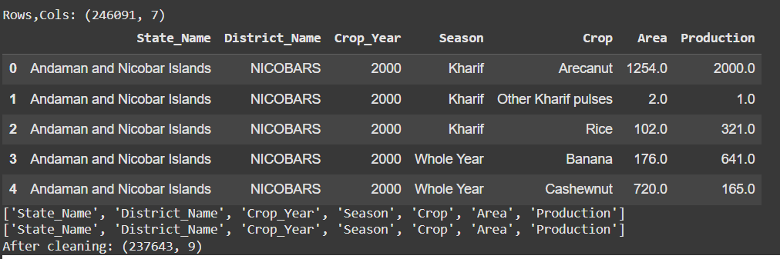
Data Analysis and Visualization Content:
Used histograms and boxplots to visualize yield distribution.
Heatmap showed strong correlation between Area and Production.
Rabi and Whole Year crops had higher and more consistent yields.
Top yielding crops: Sugarcane, Potato, Wheat.

Slide 6
Title: Model Implementation Content:
Models used: Linear Regression, Random Forest, and XGBoost.
XG Boost achieved the best results with R² = 0.91.
Evaluation metrics: RMSE, MAE, and R² Score.
Tools: Python, Pandas, NumPy, Scikit-learn, Matplotlib, Seaborn.

Slide 7
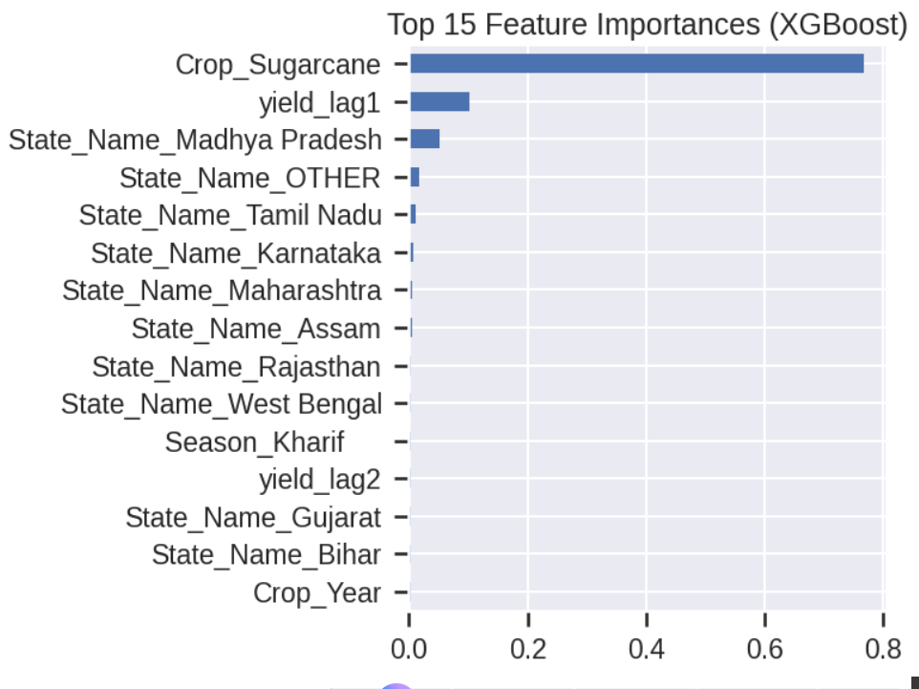
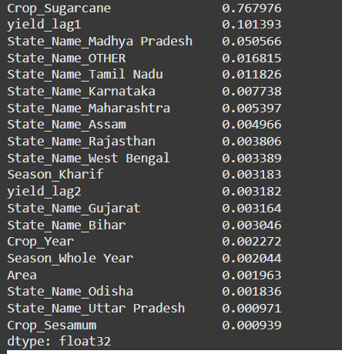
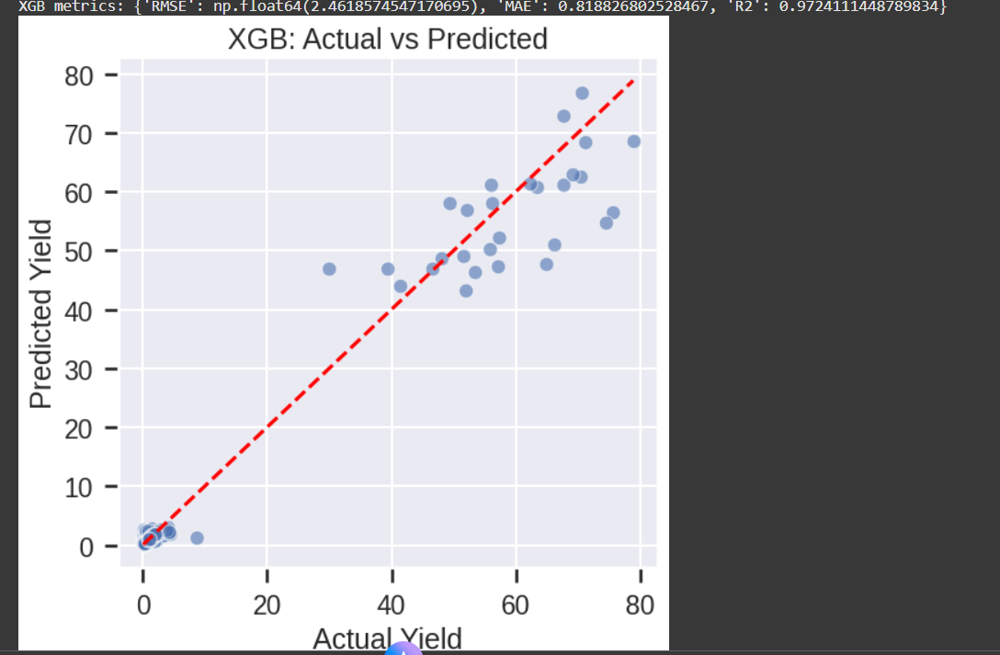

Slide 8
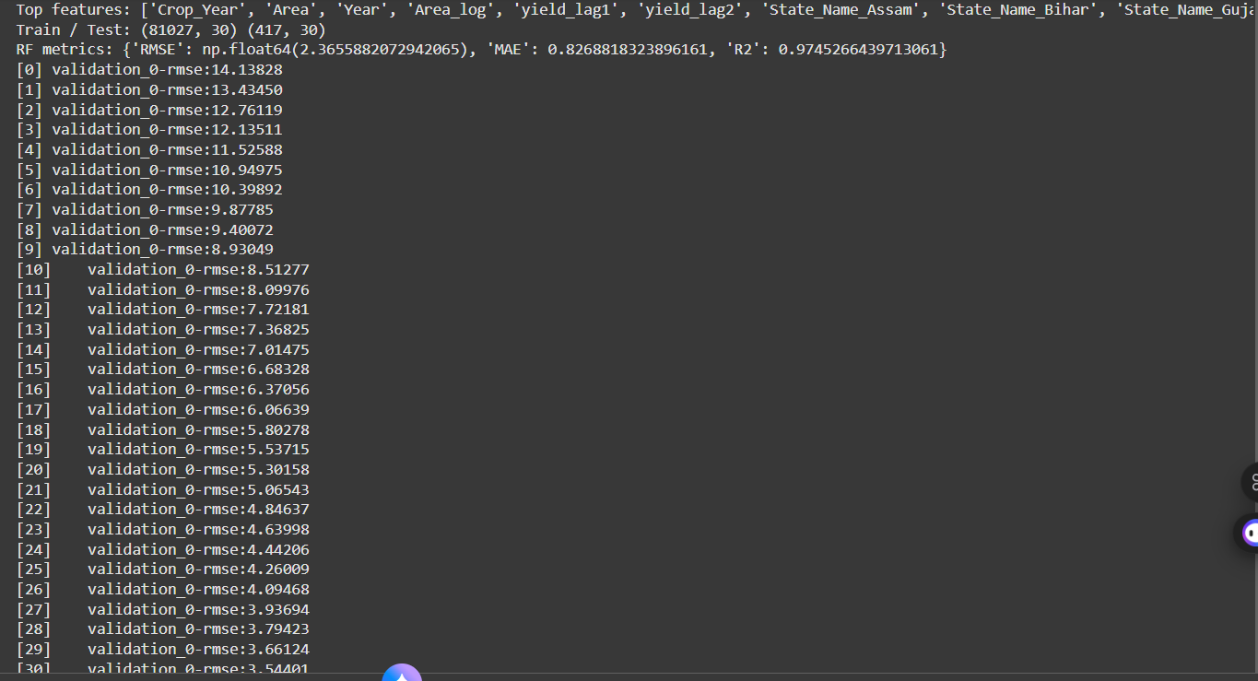
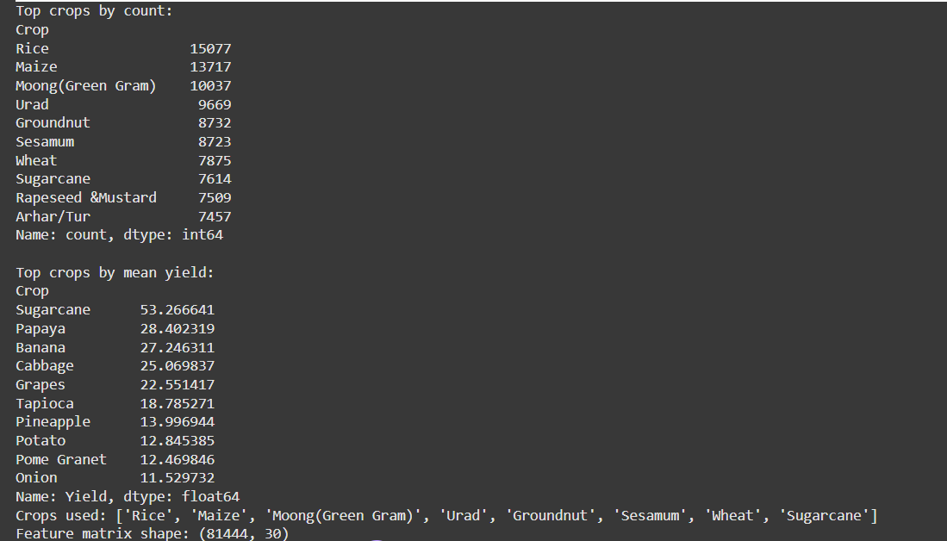
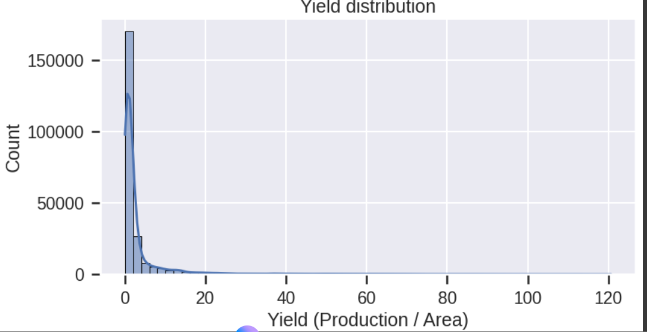

Slide 9
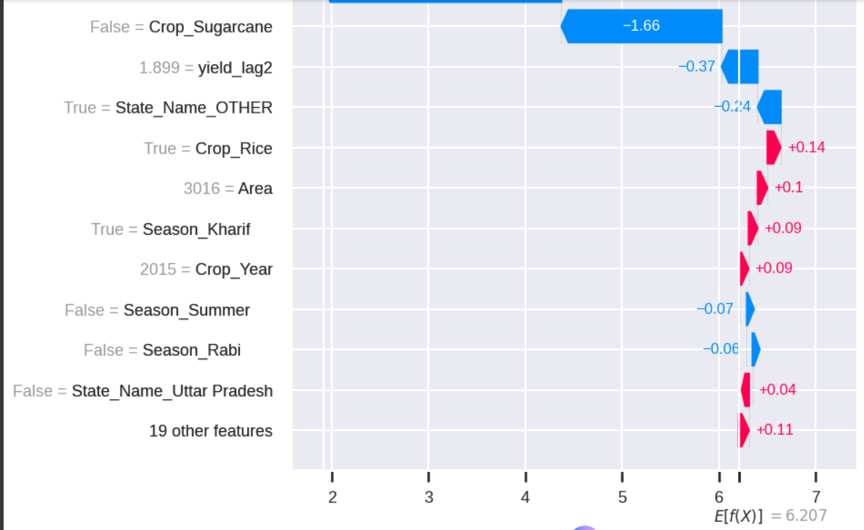
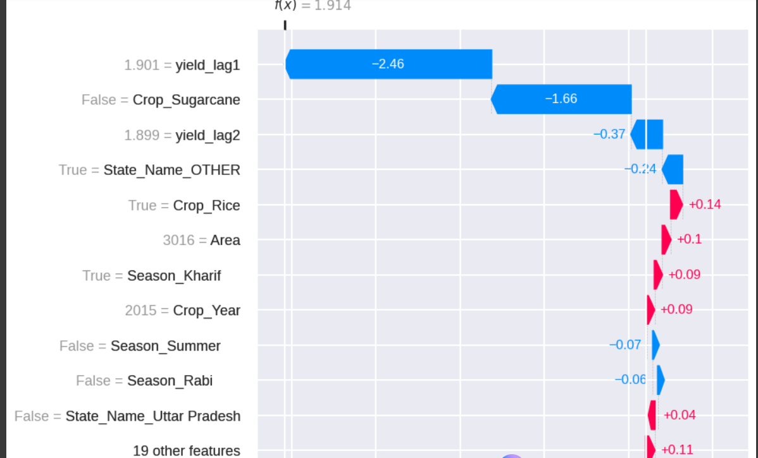
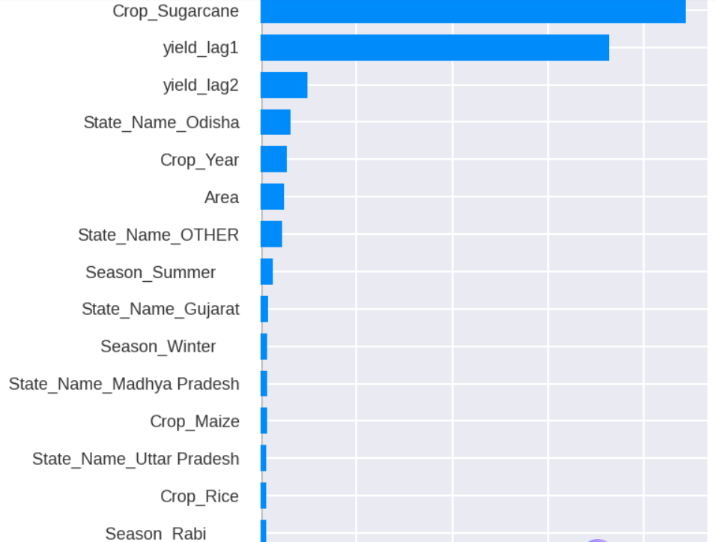
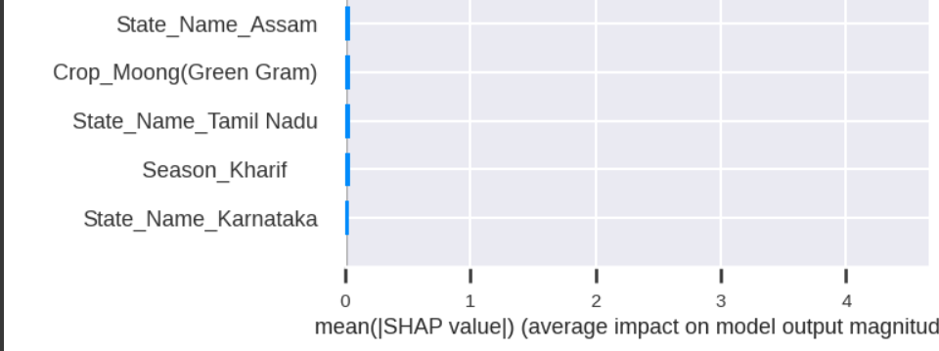

Slide 10
Title: Model Implementation Content:
Models used: Linear Regression, Random Forest, and XGBoost.
XG Boost achieved the best results with R² = 0.91.
Evaluation metrics: RMSE, MAE, and R² Score.
Tools: Python, Pandas, NumPy, Scikit-learn, Matplotlib, Seaborn.

Slide 11
Title: Results and Discussion Content:
XGBoost performed best: R² = 0.91, RMSE = 0.18.
Key predictors: Crop Type, Season, and State.
Rabi crops were more stable; Kharif crops fluctuated due to rainfall.
Confirms that data analytics plays a key role in agricultural forecasting.

Slide 12
Title: Insights and Conclusion Content:
Data analytics enables accurate, data-driven yield forecasting.
Agriculture can become more sustainable through AI-driven insights.
Limitations: Missing soil and weather data; static dataset.
Future Work: Integrate NDVI, rainfall data, and deep learning models.
Conclusion: Promotes data-driven smart farming and food security.

Slide 13
Title: Team Contribution Distribution Content:
Member 1: Suraj S. – 60%
Data collection, cleaning, feature engineering, and model development.
Model evaluation, visualization, and optimization.
Member 2: N. Charan – 40%
Exploratory data analysis, report writing, and documentation.
Designed visuals, presentation slides, and compiled final report.

Slide 14
Title: References Content:
Abhinand05, “Crop Production in India Dataset,” Kaggle, 2023.
T. Chen & C. Guestrin , “XG Boost: A Scalable Tree Boosting System,” KDD, 2016.
J. Han et al., Data Mining: Concepts and Techniques, Morgan Kaufmann, 2021.
Ministry of Agriculture, Agricultural Statistics at a Glance, Govt. of India, 2022.
FAO, “FAOSTAT: Crop Production Data,” United Nations, 2022.

Slide 15


